Slide 1
Overview of Data Communications
COSC350

Slide 2
The Essence of Data Communications
The subject is a combination of ideas and approaches from three disciplines as in 5.1
Involves the transmission of information over physical media
The subject draws on ideas about electric current, light, and other forms of electromagnetic radiation
Information is digitized and digital data is transmitted
Data communications uses mathematics and includes various forms of analysis
Goal is to develop practical ways to design and build transmission systems

Slide 3
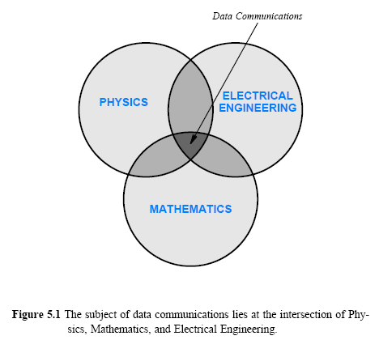

Slide 4
Motivation and Scope of the Subject
Three main ideas
The sources of information can be of arbitrary types
Transmission uses a physical system
Multiple sources of information can share the underlying medium
The first point (multimedia):
information is not restricted to bits that have been stored in a computer
information can also be derived from the physical world, including audio and video
various sources and forms of information available and one form can be transformed into another

Slide 5
Motivation and Scope of the Subject cont’
The second point (use of natural phenomena)
electricity and electromagnetic radiation, etc. to transmit information
Important issues:
the types of available media
the properties of each media
how physical phenomena can be used to transmit information over each medium
the relationship between data communications and the underlying transmission
the limits of physical systems
the problems that can arise during transmission
techniques that can be used to detect or solve the problems

Slide 6
Motivation and Scope of the Subject cont’
The third point (sharing)
A network usually permits multiple pairs of communicating entities to communicate over a given physical medium
There are possible ways underlying facilities can be shared
There are advantages and disadvantages of each sharing method

Slide 7
The Conceptual Pieces of a Communication System
Multiple sources of information and allows each source to send to a separate destination
Each source needs a mechanism to
gather the information
prepare the information for transmission
transmit the information across the shared physical medium
Each destination needs a mechanism to
extracts the information
delivers the information
Figure 5.2 illustrates the simplistic view

Slide 8
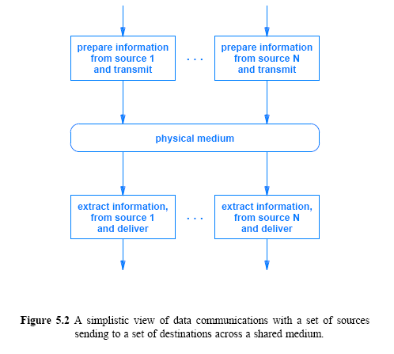

Slide 9
The Conceptual Pieces of a Communication System
More complexity
Different sources of Information
Digitization needed for the transmission
Extra data must be added to protect against channel errors
May need to be encrypted for secure transmission
To send multiple streams of information across a shared media
the information from each source must be identified
data from all the sources must be intermixed for transmission

Slide 10
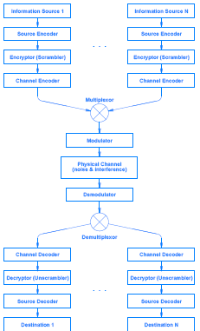
Figure 5.3
A conceptual framework for a data communications system. Multiple
sources send to multiple destinations through an underlying
physical channel

Slide 11
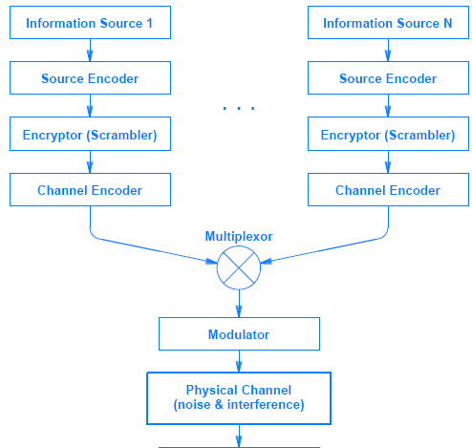
Processing at the transmitter/sender end

Slide 12
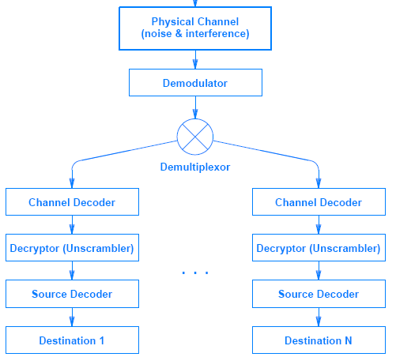
Processing at the receiver end

Slide 13
The Subtopics
Each of the boxes in Figure 5.3 corresponds to one subtopic of data communications
Information Sources
Either analog or digital
Characteristics of signals
amplitude, frequency, and phase,
periodic or aperiodic
Source Encoder and Decoder
Once digitized, digital representations can be transformed and converted
Concepts include data compression and consequences for communications

Slide 14
The Subtopics con’t
Encryptor and Decryptor
Information can be encrypted and decrypted
Cryptographic techniques and algorithms
Channel Encoder and Decoder
Channel coding is used to detect and correct transmission errors
Parity checking, checksums, and cyclic redundancy codes
Multiplexor and Demultiplexor
Multiplexing: information from multiple sources is combined for transmission across a shared medium
Simultaneous sharing or taking turns when using the medium

Slide 15
The Subtopics con’t
Modulator and Demodulator
Modulation refers to the way electromagnetic radiation is used to send information
analog and digital modulation schemes
modems
Physical Channel and Transmission
transmission media
transmission modes, such as serial and parallel
channel bandwidth
electrical noise and interference
channel capacity

